Slide 1
The Fall of Rome and the beginning of the Middle Ages.

Slide 2
Fall of the Roman Empire
Rome was the most powerful empire the world had ever seen.
Its architecture was Hellenistic and its road system was as impressive as that of the Inca in S. America

Slide 3
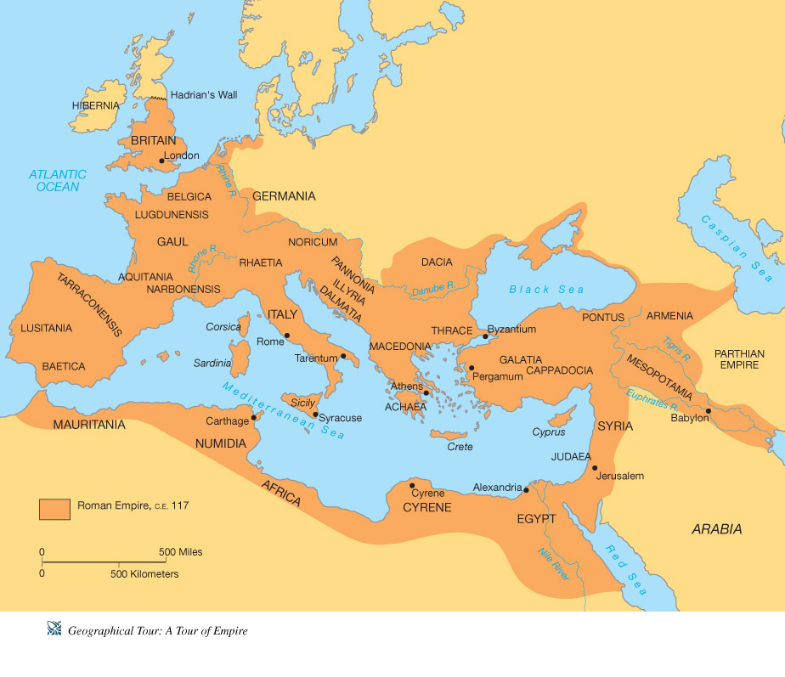
Roman Empire at its height 117 C.E.

Slide 4
Roman legal accomplishments
Rome had a republican democracy sometimes
Rome had a senate where patricians could represent people

Slide 5
Rule of Law
It means nobody is above the law, not the king, not the senate, not the people, not the police.
Laws are written down and must be respected

Slide 6
Rule of Law!!

Slide 7
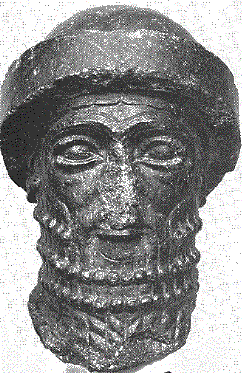
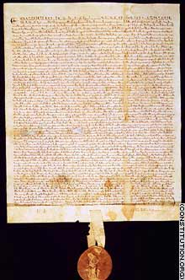
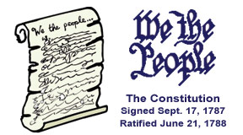
Three other examples

Slide 8
Disease led to its Fall
"Realizing what a deadly disaster had come to them, the people quickly drove the Italians from their city. But the disease remained, and soon death was everywhere. Fathers abandoned their sick sons. Lawyers refused to come and make out wills for the dying. Friars and nuns were left to care for the sick, and monasteries and convents were soon deserted, as they were stricken, too. Bodies were left in empty houses, and there was no one to give them a Christian burial."

Slide 9
Bubonic plague “Black plague”
It was called the black plague because of the dark spots found on its victims

Slide 10
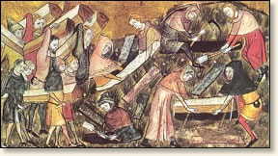
Coffins were rare, most were buried in mass graves!

Slide 11
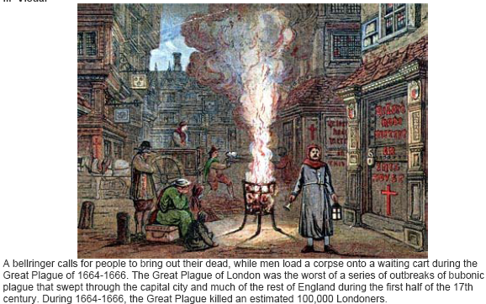

Slide 12
Why was Rome so affected by the Plague?

Slide 13
Fall of Rome
Rome was besieged by various tribes from modern day Germany and France.

Slide 14
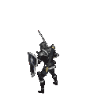
Although the fall of the Roman Empire did not happen overnight, many consider its fall the beginning of the Middle Ages or Dark Ages.

Slide 15
Major Eras of European History
Classical Era (Greece and Rome) 500 B.C.- 600 A.D.
Middle Ages (time of knights and castles) 500 A.D. – 1500 A.D.
Early Modern Era (time of powerful kings and exploration) 1500 A.D. – 1776 A.D.

Slide 16
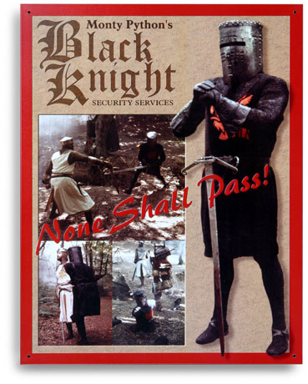
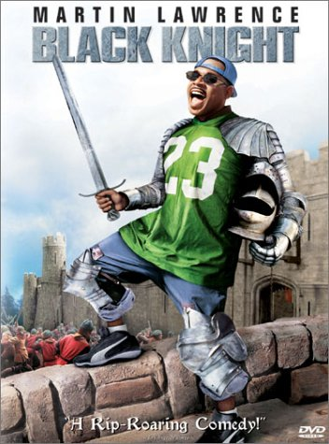
Knights!

Slide 17
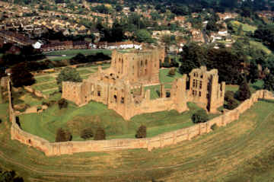
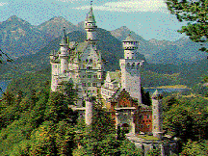
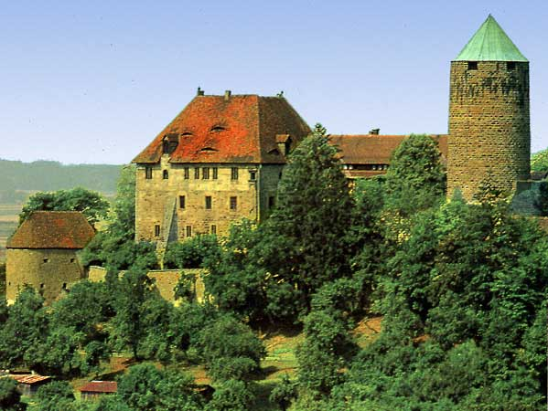
Castles!

Slide 18
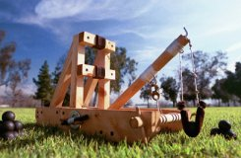
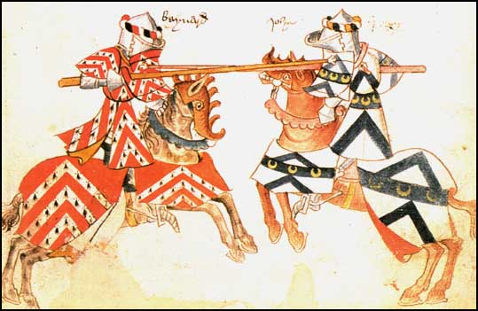
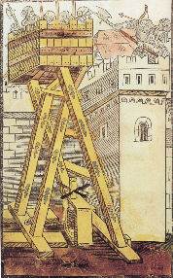
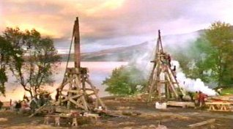
Feudal Warfare!!!!

Slide 19
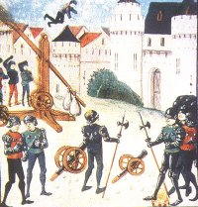
Trebuchets were used to hurl all sorts of objects at the enemy.

Slide 20
The Middle Ages were a dangerous time in Europe
The strong empires of Rome and Greece that protected trade routes and encouraged science and personal liberties were fading away.
The Roman empire not only had to fight the plague but fight invaders from Europe and Asia.

Slide 21
Genghis Kahn Mongolian warrior

Slide 22
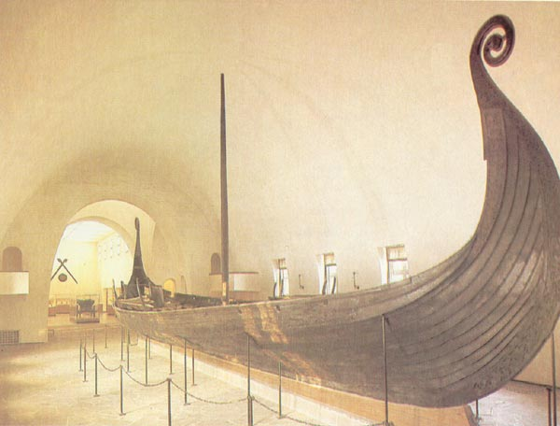
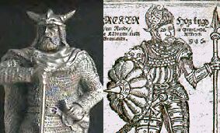
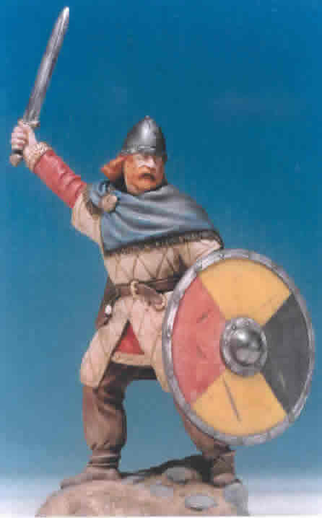
Vikings!

Slide 23
No more large cities, trade, scholarship.
With all the disease, riots, outside attacks and starvation people fled the cities of the once strong Roman empire.
In Europe, people now lived on manors, self-sufficient communities consisting of a castle, church, village and surrounding farmlands.

Slide 24
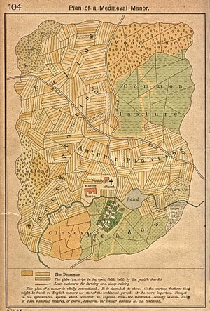

Slide 25
Manoralism (econ. system)
or safety and for defense, people in the Middle Ages formed small communities around a central lord or master. Most people lived on a manor, which consisted of the castle, the church, the village, and the surrounding farm land. These manors were isolated, with occasional visits from peddlers, pilgrims on their way to the Crusades, or soldiers from other fiefdoms.
Why do you think everyone chose to be isolated?

Slide 26
Feudalism (political system)
The kings had lots of land; he gave land to lords in exchange for protection and $.
Lords gave their land to knights in exchange for protection, $.
Knights let serfs work the land and he would protect them.
Serfs got food and shelter.
Thus, each person had rights and responsibilities

Slide 27
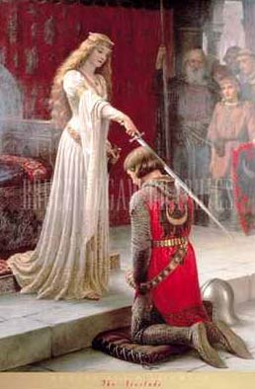
Chivalry- code of honor

Slide 28
Magna Carta
Signed in 1215
Example of Rule of Law
English King John was a bad king so his nobles forced him to sign it.
Limited powers of king.

Slide 29
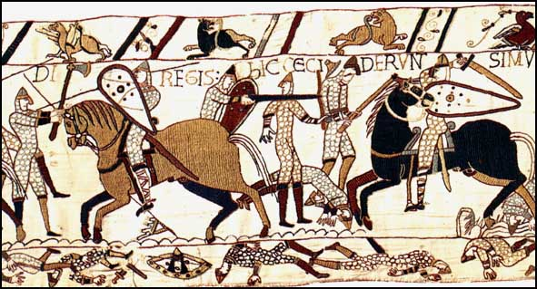
There are 2 wars you need to know about.
In 1066, England was invaded by Normans (Vikings from modern-day France) and conquered all of England

Slide 30
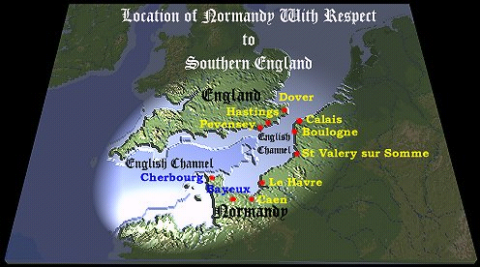

Slide 31
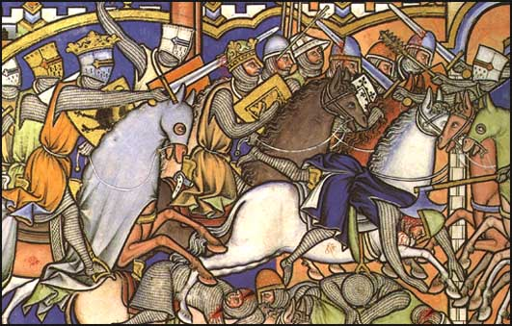
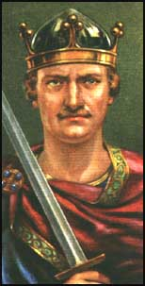
William of Normandy helped make England what it is today and codified feudalism (gave it the force of law).

Slide 32
Crusades
The Crusades were a series of battles between Christians and Muslims in the Middle East.
Christian knights wanted to take the Holy Land and give it back to Christians

Slide 33
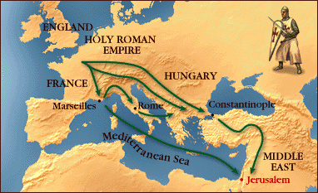
Why was Constantinople so important geographically?

Slide 34
Crusades
Thousands of knights and “barbarian” soldiers united under Christianity attacked Muslims and Jews in Turkey and Jerusalem to gain the land for Christians.

Slide 35
The Arab world was relatively peaceful and civilized at the time. An Arab gentleman was expected to be a poet and philosopher as well as a warrior. They had correctly calculated the distance from earth to the moon. And one Arab had even suggested that if he could split the atom, it would release enough power to destroy a city the size of Baghdad. Furthermore, Jerusalem itself was a multicultural city. Jews, Moslems and Christians all lived together harmoniously. Christians on pilgrimages to Jerusalem were freely allowed across to the Holy Places

Slide 36
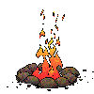
When the Crusades arrived in Northern Turkey, the carnage began. The town of Lycea was captured and looted. Reports told of babies cut to pieces. Old people were subjected to every kind of torture. Unfortunately, most of the inhabitants of Lycea were actually Christians…

Slide 37
Impact of the Crusades
Persecution of Jews and Muslims
Economic development via trade
Kings and popes, gained power as a result.

Slide 38
Role of Church in Middle Ages
Never was there a time when the Church was so powerful in Western Civilization.
The Church was led by popes. Priests and nuns converted, gave care to people

Slide 39
Role of Church
Monks were spiritual leaders (obviously)
They lived in monasteries that acted like trade schools and YMCAs

Slide 40
Role of Church
They spent years transcribing the Bible since the printing press wasn’t used in Europe yet.

Slide 41
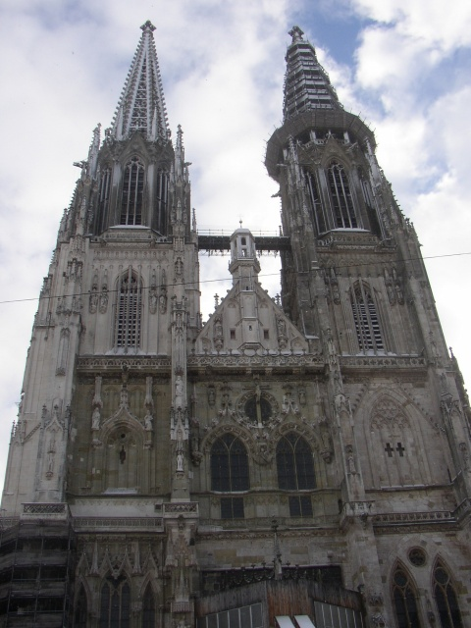
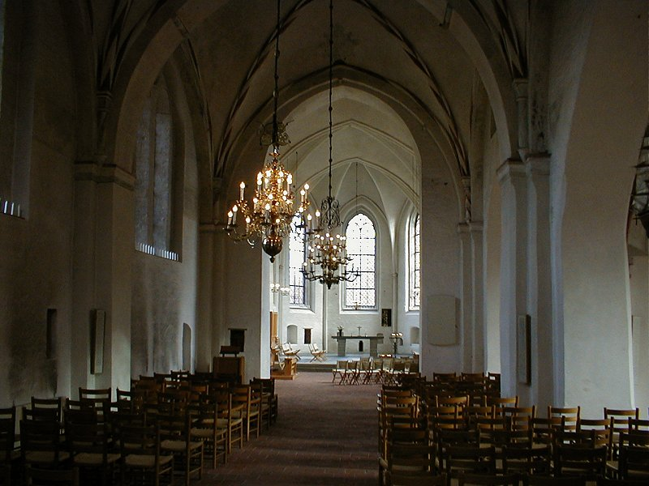
Churches and Cathedrals during the Middle Ages

Slide 42
Role of Church
Since there were no strong empires or kingdoms the Church was one organization that had respect and power.
Popes were more powerful than kings!

Slide 43
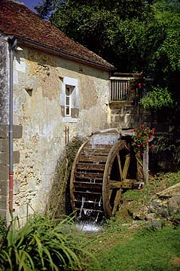
Important Middle Ages Technologies
Water Wheel
Eyeglasses
Mechanical Clock
Printing
Gunpowder

Slide 44
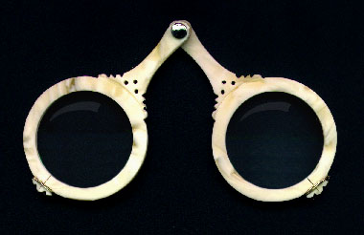
Eyeglasses
Invented in Pisa 13th century
By 15th century Italy making thousands spectacles
Eyeglasses encouraged invention of fine instruments
Gauges
Micrometers
Fine wheel cutters
Precision tools

Slide 45
Mechanical Clock
Undermined Church authority
equal hours for day and night a new concept
Resisted by the church for a century
Every town wanted one
Public clocks installed in towers
Conquerors seized as spoils of war
Allowed individual autonomy
Work now measured by time
increased productivity
Bern, Switzerland

Slide 46
Gunpowder
Europeans improved gunpowder to siege castles
Europeans focused on range and weight of projectiles: siege warfare
With improved metal casting, made world’s best cannon

Slide 47
Summary
The Roman Empire fell due to outside attacks and disease (brought on by trade)
The Middle Ages began as the Church replaced governments as the central authority.

Slide 48
Feudalism/ Manoralism came from people’s need for protection. Each member had rights and responsibilities.
Cultures interact through wars, such as the Crusades, and trade ideas such as democratic ideas or religious ideas

Slide 49
Any questions before the quiz?

Slide 50
1. What 2 reasons did the Roman empire cease to be a powerful empire?
2. Name 2 examples of Rule of Law
3. What was the economic system of the Middle Ages in Europe?

Slide 51
4. Under Feudalism, what responsibility does a knight have? What does he give in return?
5.In what year did William of Normandy invade England?
6. What were the Crusades?

Slide 52
7. What era (time period) describes the time of Greece and Rome?
8. What year was the Magna Carta signed?

Slide 53
This powerpoint was kindly donated to www.worldofteaching.com
http://www.worldofteaching.com is home to over a thousand powerpoints submitted by teachers. This is a completely free site and requires no registration. Please visit and I hope it will help in your teaching.

